Slide 1
UML
Sequence Diagrams

Slide 2
What are sequence diagrams?
“… a sequence diagram captures the behavior of a single scenario. The diagram shows a number of example objects and the messages that are passed between these objects within the use case.”
Martin Fowler – UML Distilled

Slide 3
Landscape
Diagram
Structure Diagram
Profile Diagram
Composite Diagram
Component Diagram
Deployment Diagram
Package Diagram
Object Diagram
Class Diagram
Behavior Diagram
Use Case Diagram
Activity Diagram
Interaction Diagram
Sequence Diagram
Communication Diagram
Timing Diagram
State Machine Diagram

Slide 4
Sequence Diagrams
The Basics

Slide 5
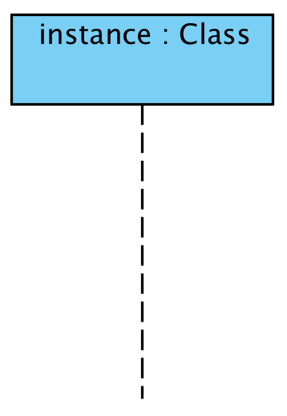
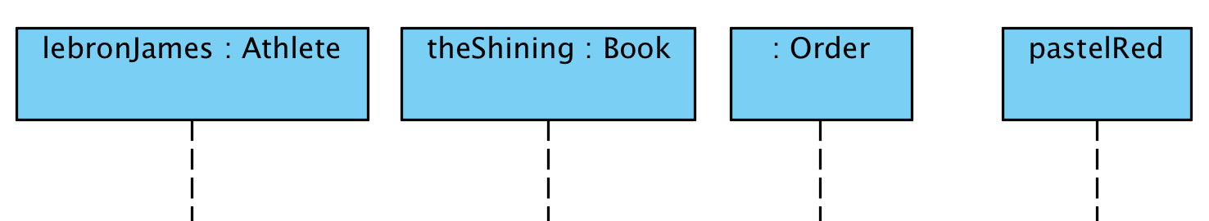
Elements of Sequence Diagram
Participants
Represent objects and roles (with associated classes)
Valid Notations
instanceName: ClassName
: ClassName
instanceName

Slide 6
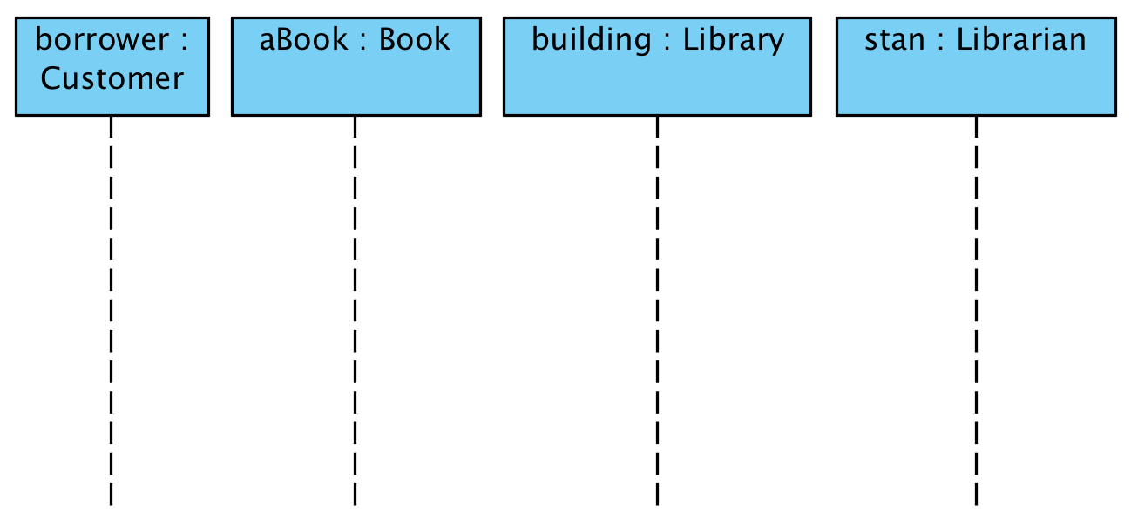
Lifelines
Lifelines are displayed below each partipant
They represent the life cycle of an object
Time increases from top to bottom
Time

Slide 7
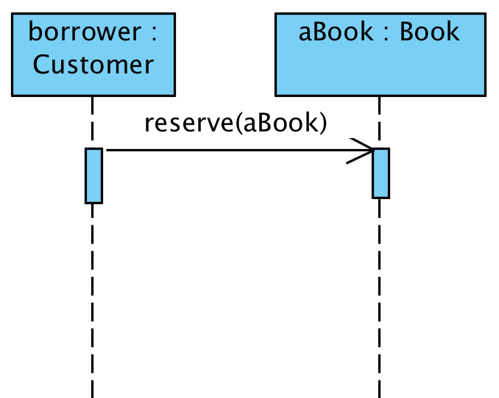
Messages
Represent method calls between objects
Can also represent more abstract concepts such as message passing between processes or real world entities

Slide 8
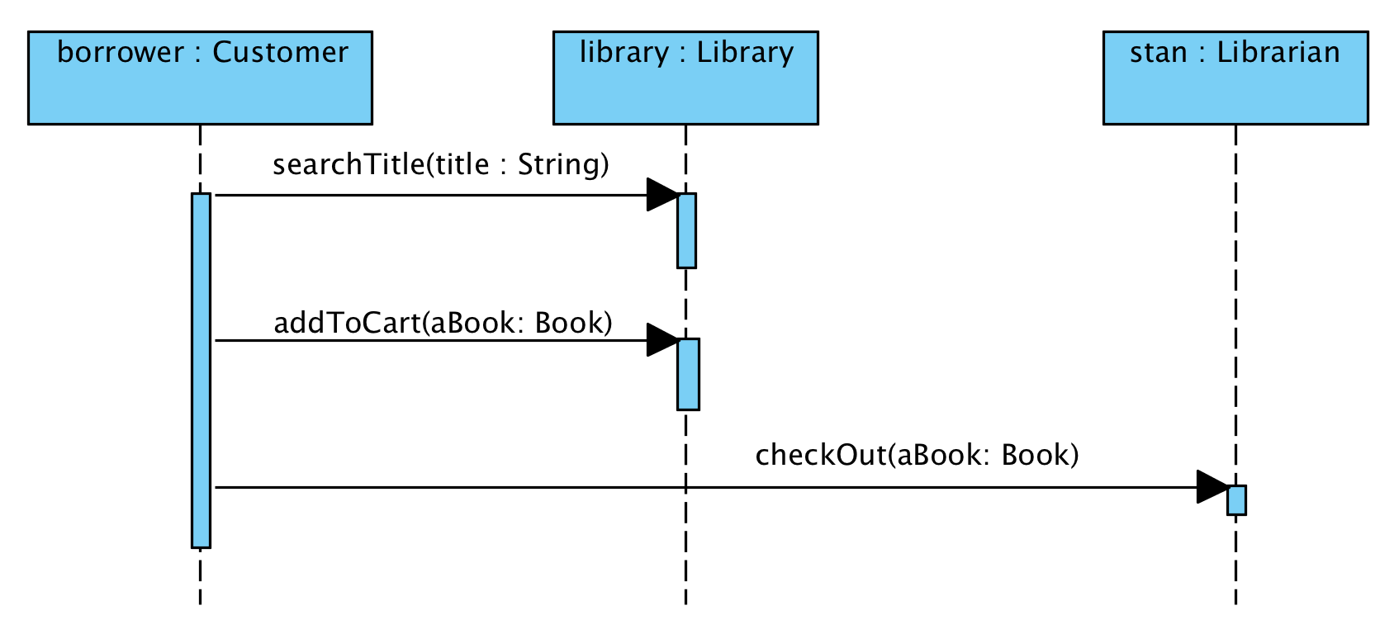
Activations
Represent method calls on a lifeline
Activation

Slide 9
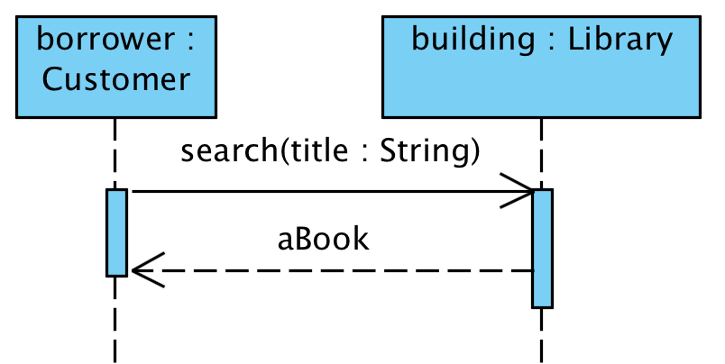
Messages, replies
Methods calls and return values are denoted separately

Slide 10
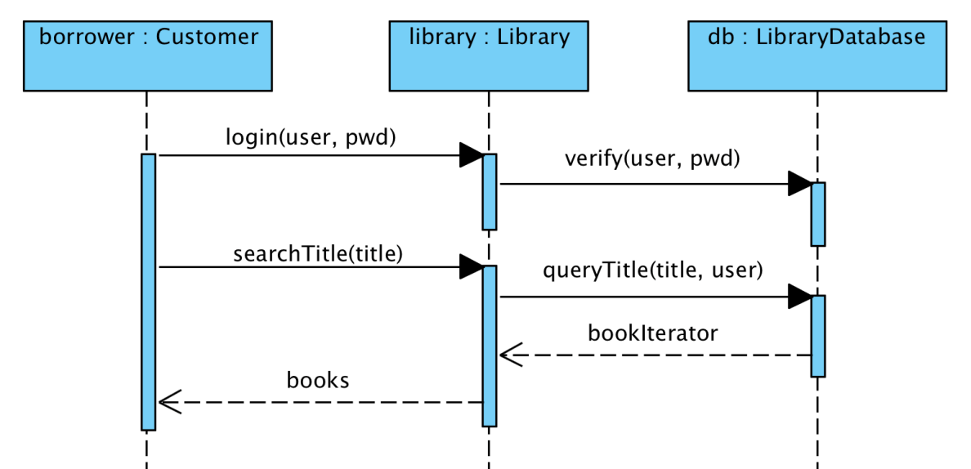
Nested messages
Nested activations (method calls) are common
What order do these methods occur in?

Slide 11
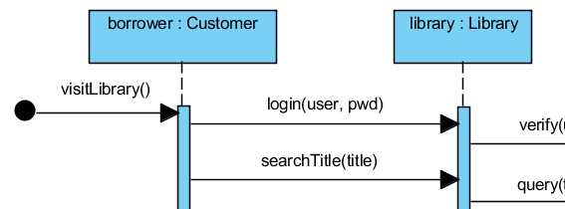
Found messages
Determines an initial message that starts the sequence diagram
The message comes from outside the scope of the system of interest
Found Message

Slide 12
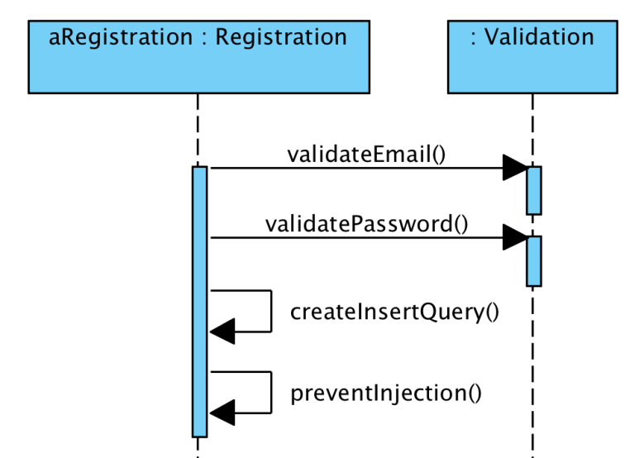
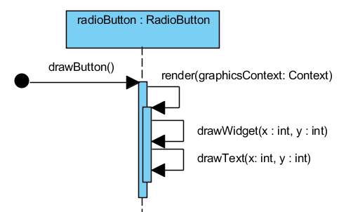
Self, recursive calls
Self calls
Recursive calls
a call to another method in the same class
Shows recursion or denote nested method calls
Recursive Call
Nested Self Call
Self Call

Slide 13
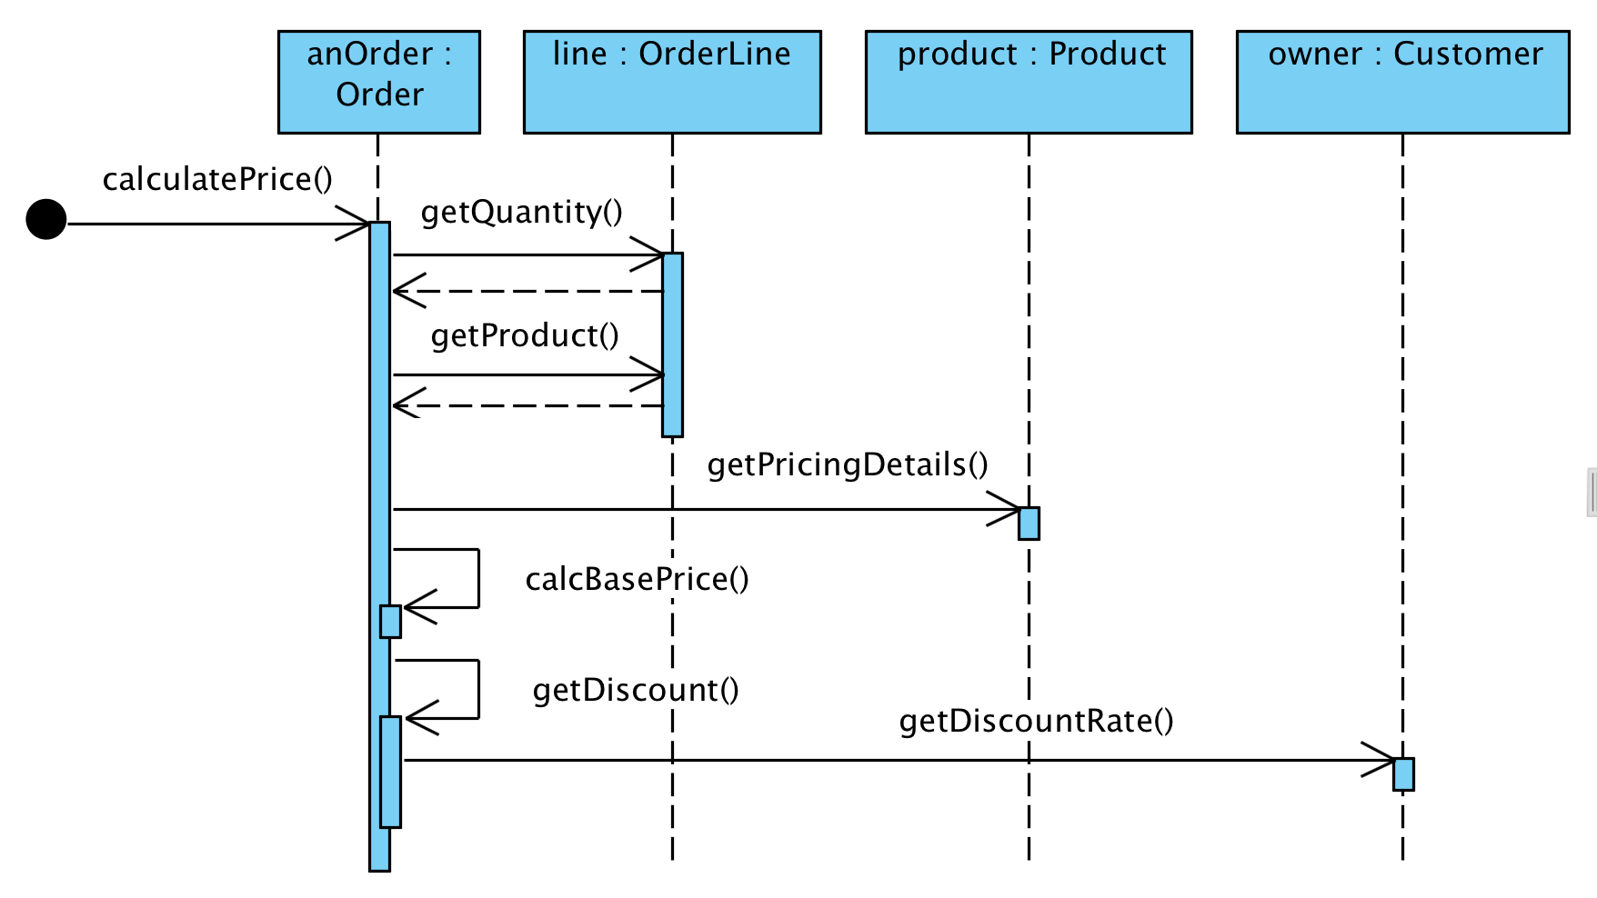
Example from UML Distilled
Use Case: calculating the price of an order

Slide 14
Example from UML Distilled
Matching our terminology
participant
lifeline
found message
activation
return value
message
self-call

Slide 15
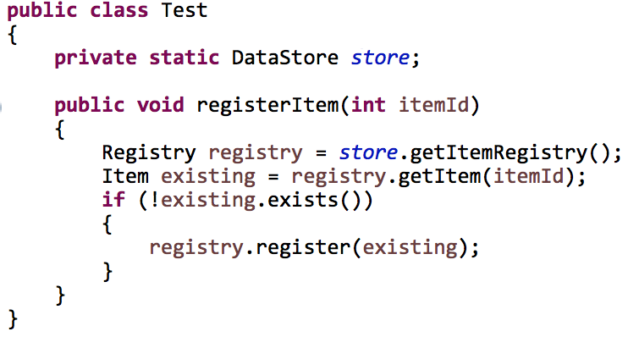
Another example
How would you write the sequence diagram for Test.foo()?

Slide 16
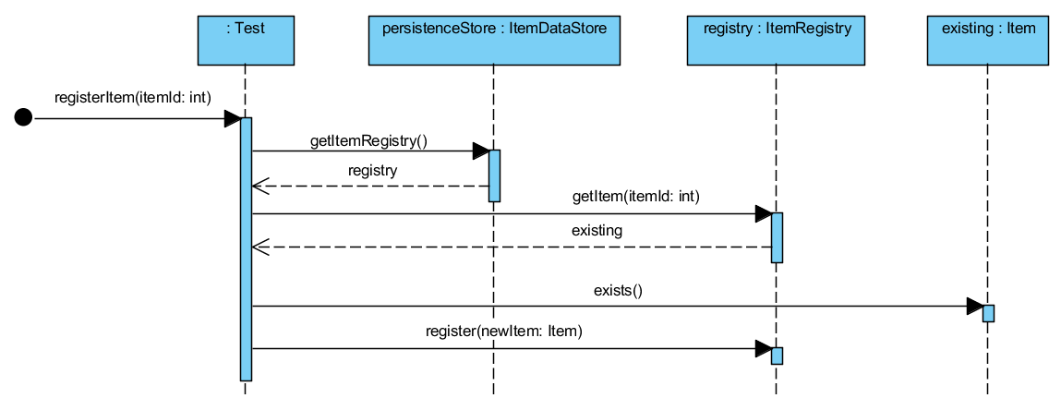
Another example

Slide 17
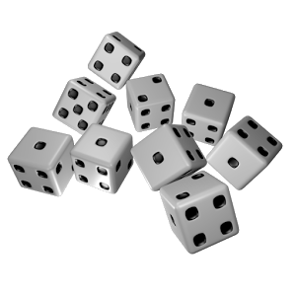
Let’s practice!

Slide 18
Sequence Diagrams
Advanced Concepts

Slide 19
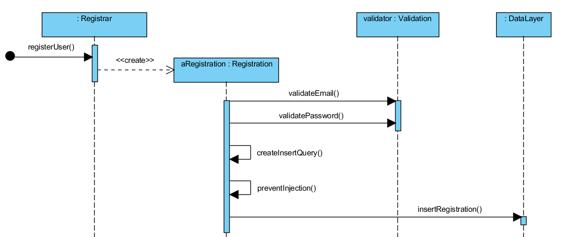
Creating objects
A message sent to a participant denotes object creation (using a dashed line)

Slide 20
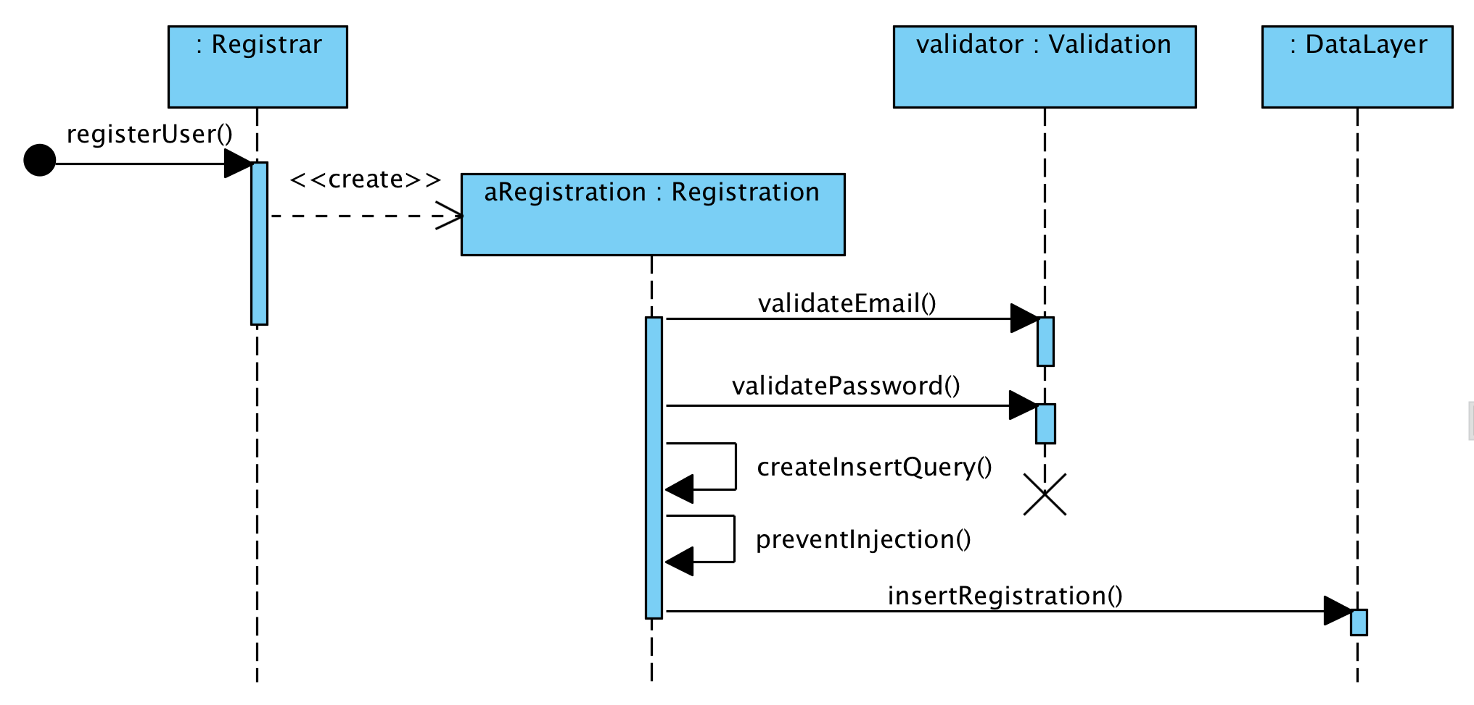
Deleting objects
You can denote the end of an object’s life cycle

Slide 21
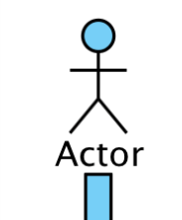
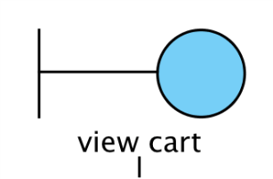
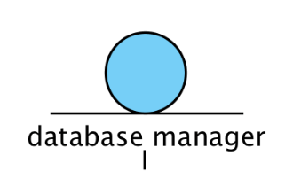
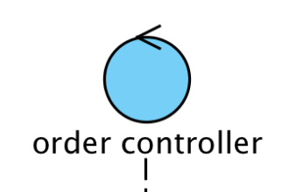
Other Participants/Lifelines
Actors
Represent users and their interactions in a system
Boundary object
Represent users or GUIs (views) in a system
Entity object
Represents a data or domain object (model)
Control object
Controls interactions between boundary and entity objects (controller)

Slide 22
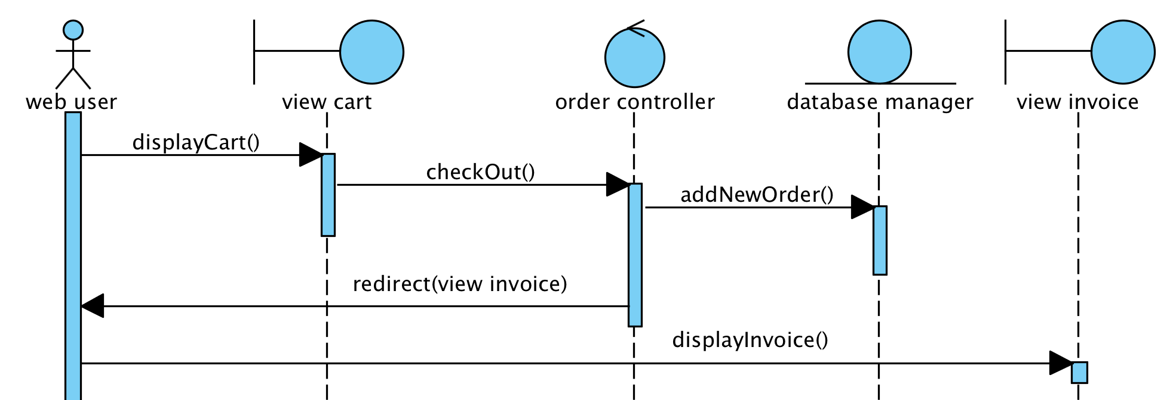
Another example
Online ordering system
A user reviews their cart and then submits their order. An invoice is displayed to the user.

Slide 23
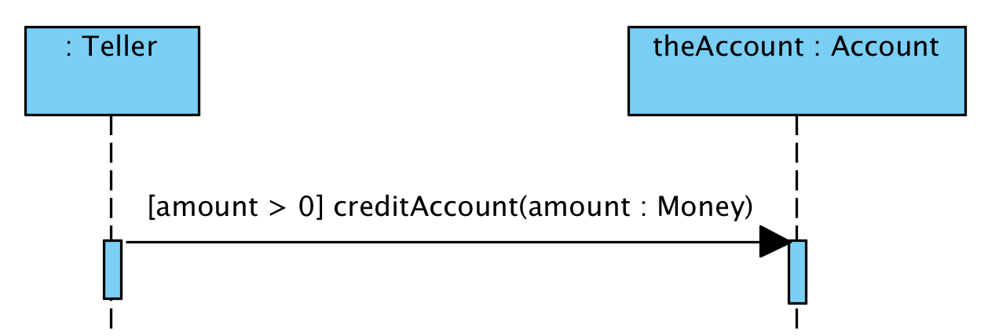
Guards
Used to denote constraints on a message

Slide 24
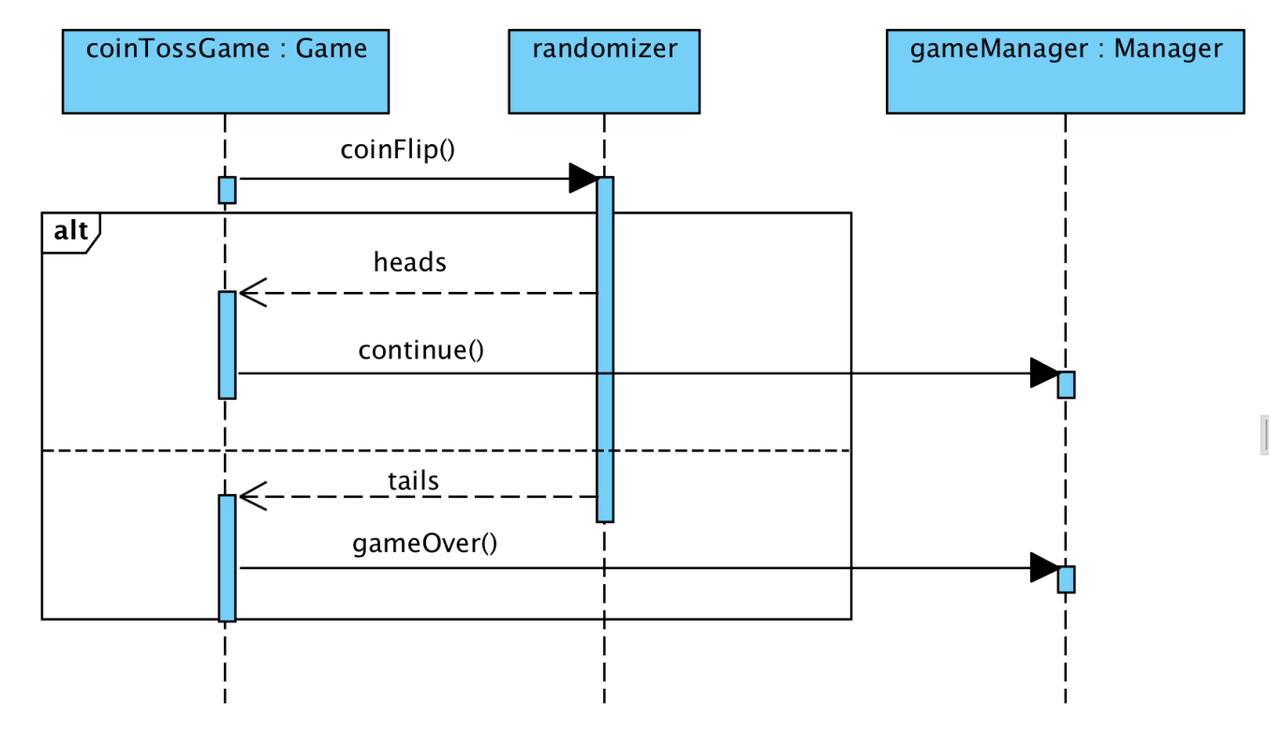
Alt Fragments
Represent alternative actions that are mutually exclusive
Each action is represented as part of a combined alt fragment

Slide 25
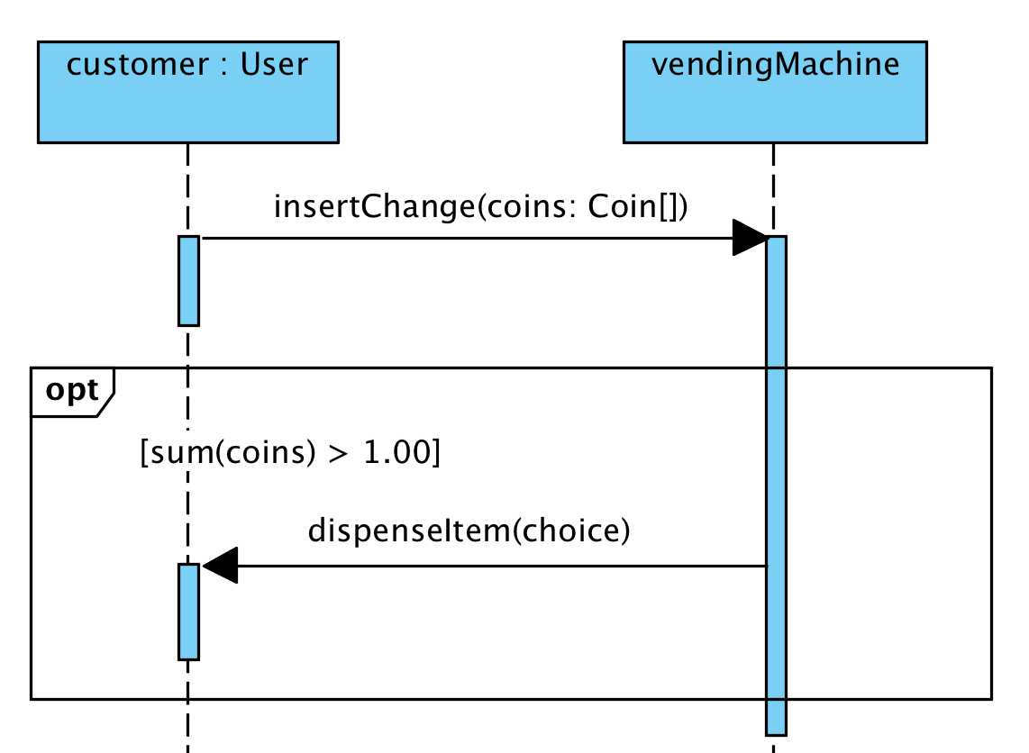
Option fragments
Represent if statements
The frame is controlled by an operand (a boolean expression)

Slide 26
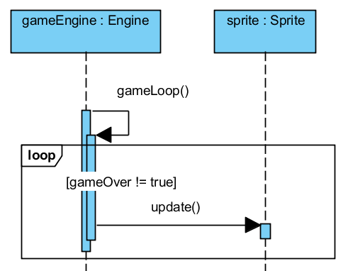
Loop fragments
Represent loops
The frame is also controlled by an operand (boolean expression) which determines how long the loop continues

Slide 27
Sources
Fowler, Martin. UML Distilled. New Jersey: Pearson Education, 2004.

Slide 28
UML
Sequence Diagrams

